Slide 1
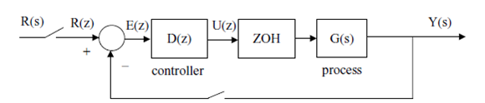
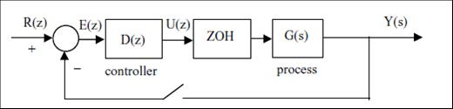
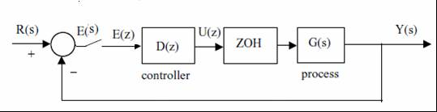
DISCRETE CONTROLLER
Discrete-time system with analog reference input
Discrete-time system with discrete reference input
Discrete-time system with Analog error calculation .(Digital controller samples error)

Slide 2
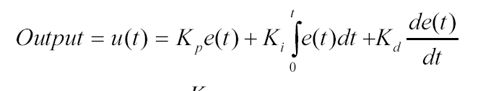
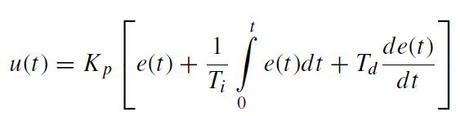

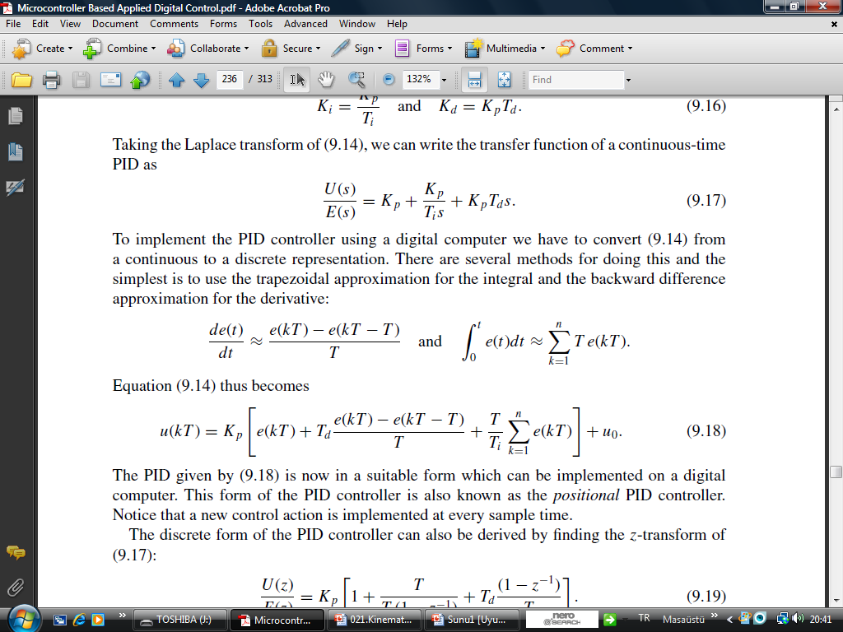
Discrete implementation
of PID controller
To implement the PID controller using a digital computer we have to the PID equation must be converted to a discrete representation. There are several methods for doing this and the simplest is to use the trapezoidal approximation for the integral and the backward difference approximation for the derivative:

Slide 3

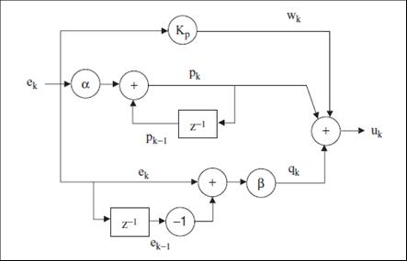





PID CONTROLLER IMPLEMENTATIONS:
P
I
D

Slide 4
Example program (PID controller in speed control) in C like code:
……………………………………….
…………………………………………………
//***********************Init***************
error=ref-speed; //actual error=reference-actual speed acquisition
if(IsOverflow()) error=127; //error saturation(Limits of signed byte)
else if(IsUnderflow()) error=-128;
//********** Proportional action****************
prop=kp*error; //sword variable=costant*sbyte variable
//************** End_proportional action ******************
//************** Integral action **************************
{integral=integral+error; //actualisation of integral factor
integ=ki*integral; //sword=costant*sbyte
//**************** End_integral action********************
//******************** Derivative action *****************
derivative=error-error_old; //actualisation of derivative component
der=kd*derivative;
//*************** End_derivative action ******************
error_old=error; //store actual error for next control step
increment=prop+integ; //sum of component integral and proportional
increment=increment+der; //sum of component derivative
//******************* End of PID regulator *************

Slide 5
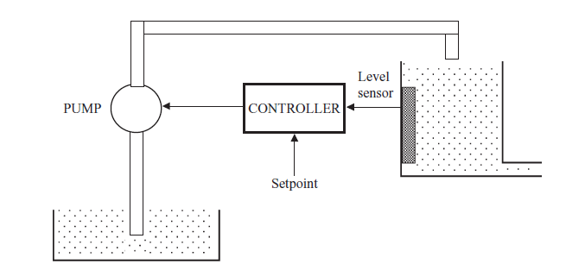
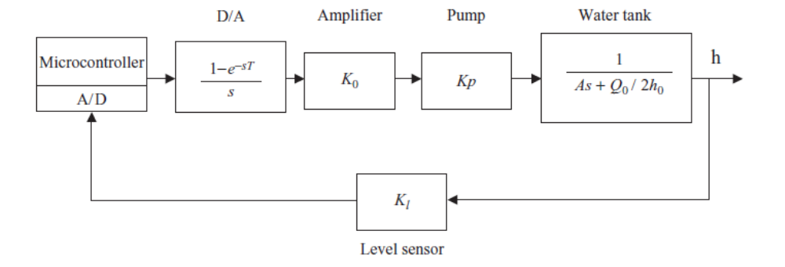
Example application: Liquid Level Digital Control System: A Case Study: PI

Slide 6
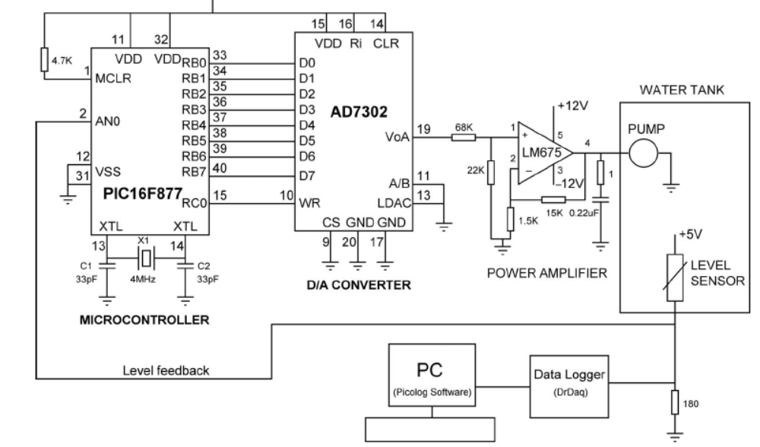

Slide 7
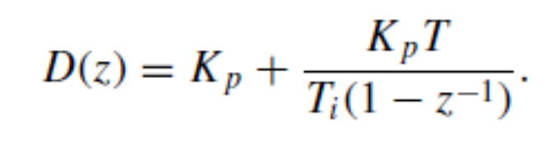
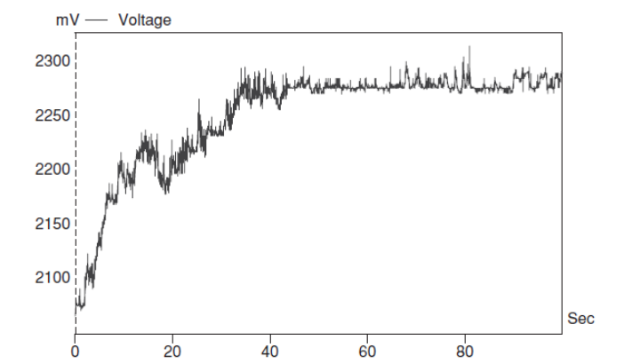
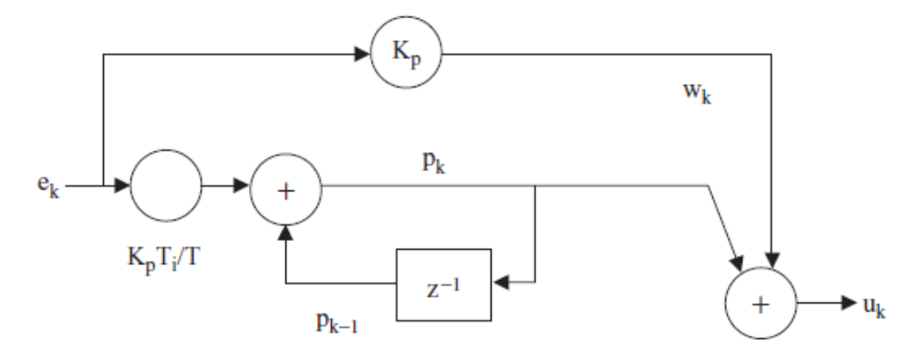
Realization of the PI controller

Slide 8
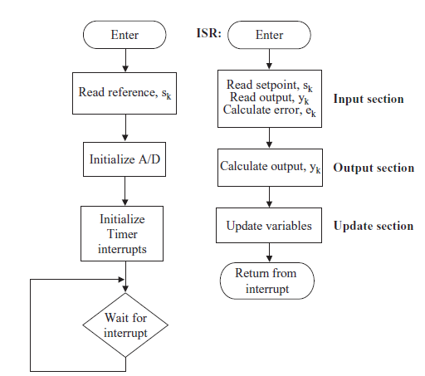
MICROCONTROLLER IMPLEMENTATIONS

Slide 9
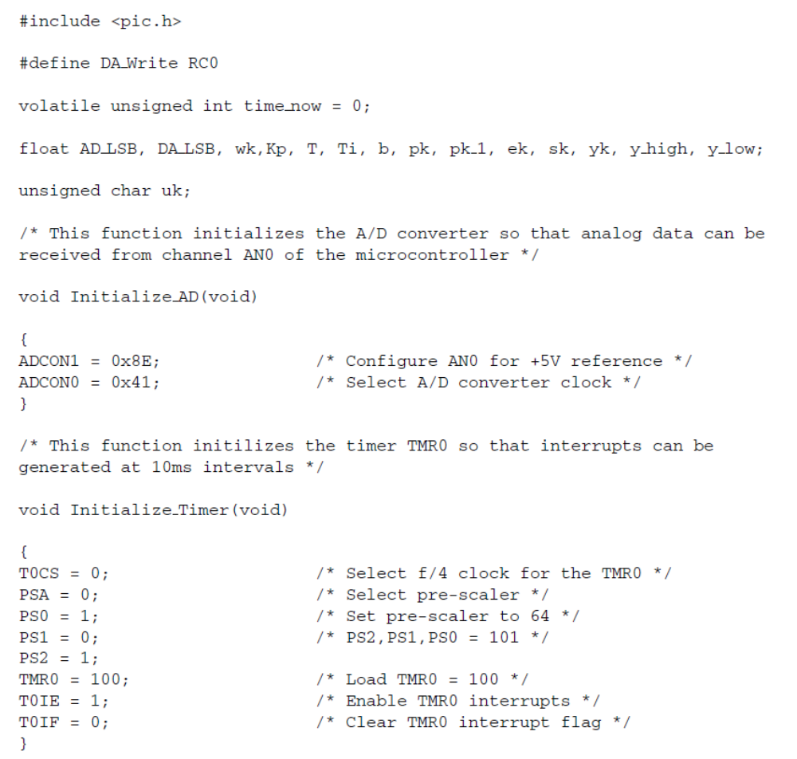
ADC module
Timer

Slide 10
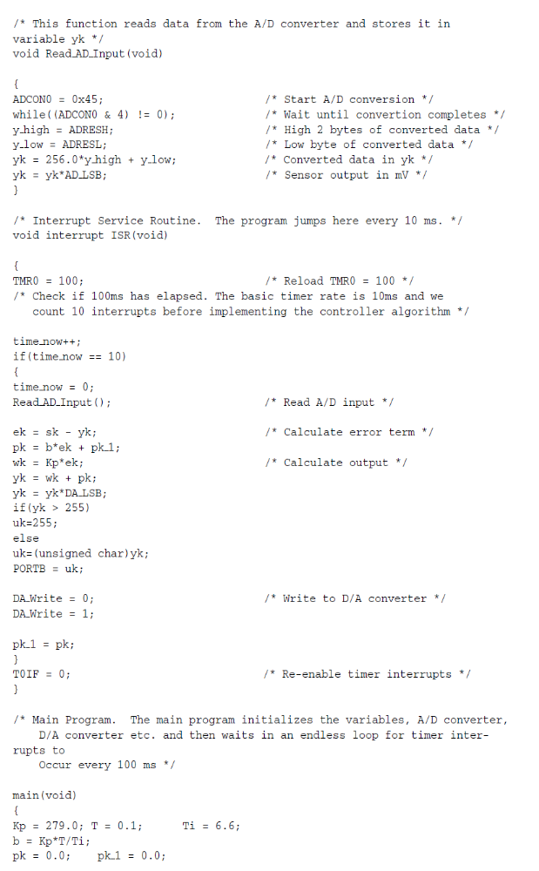
ADC Conversion
Timer interrupt

Slide 11
Error calculation and control

Slide 12
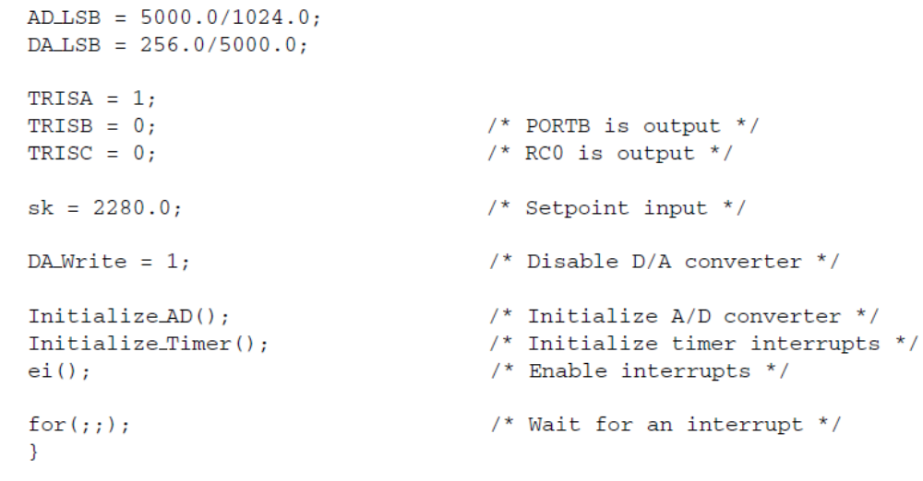

Slide 13
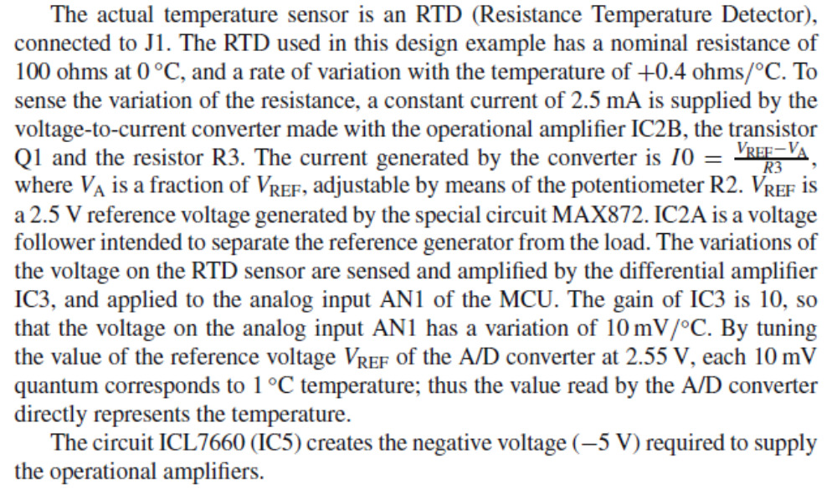
Hardware Implementation of a Microcontroller-Based Temperature Controller
Closed loop temprature control

Slide 14
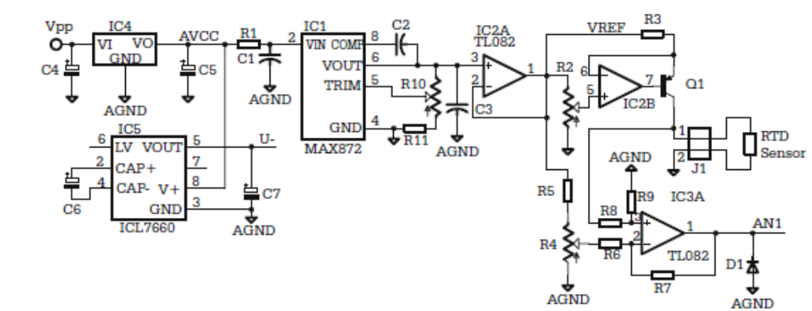

Slide 15
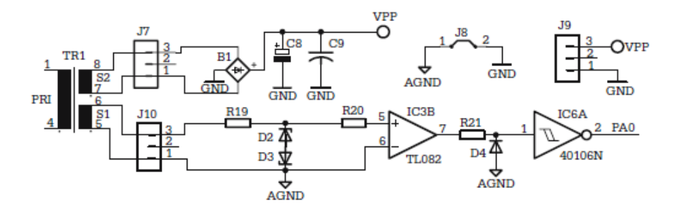
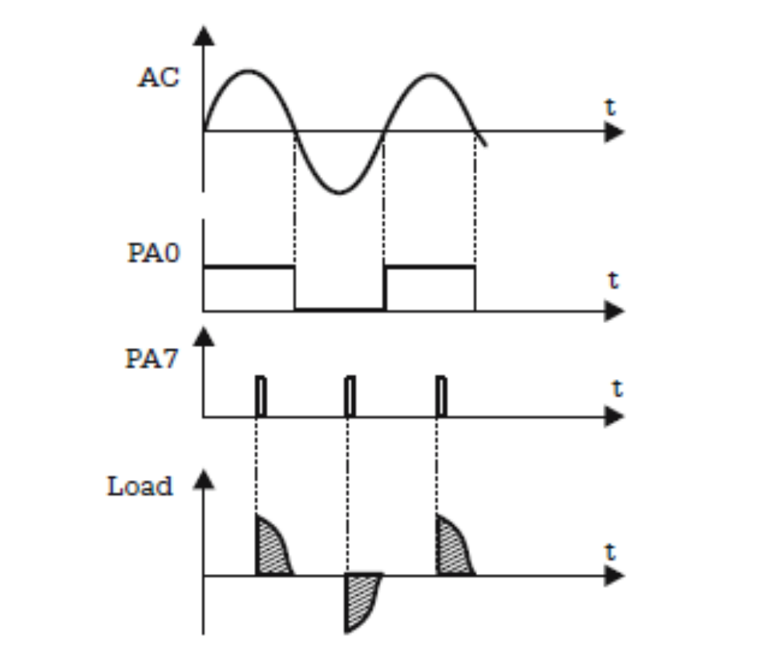
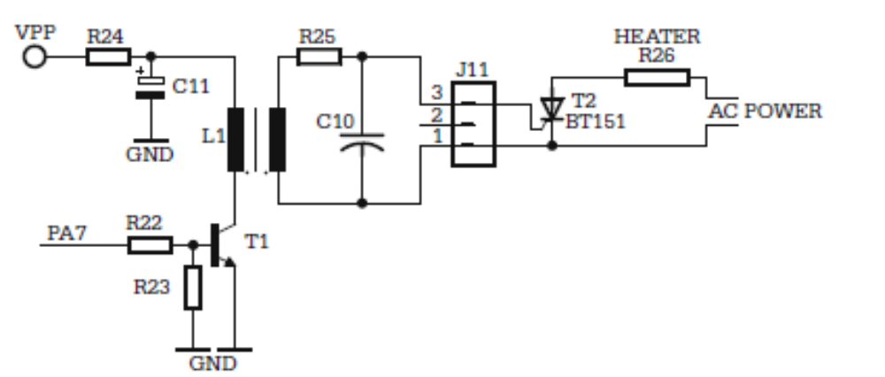
Schematic of the zero crossing detector and Heater controller

Slide 17
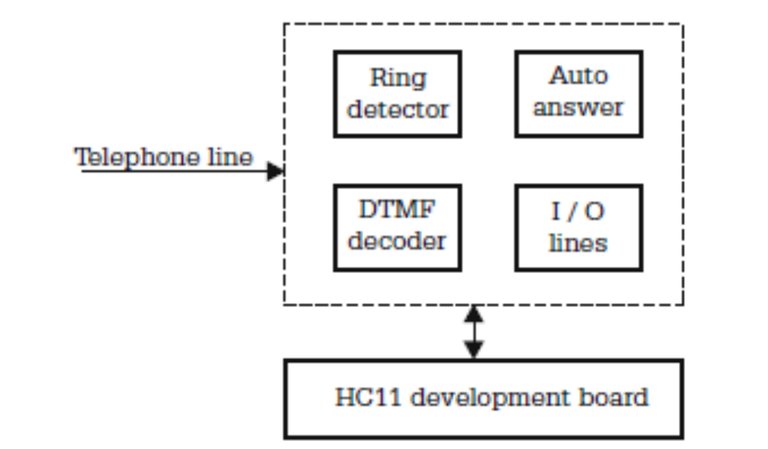
Remote Relay Controller over Telephone Lines
This example contains the description of a device that interfaces a
microcontroller to a telephone line, and is capable of receiving and
decoding a series of DTMF signals, and to execute commands received this way.

Slide 18
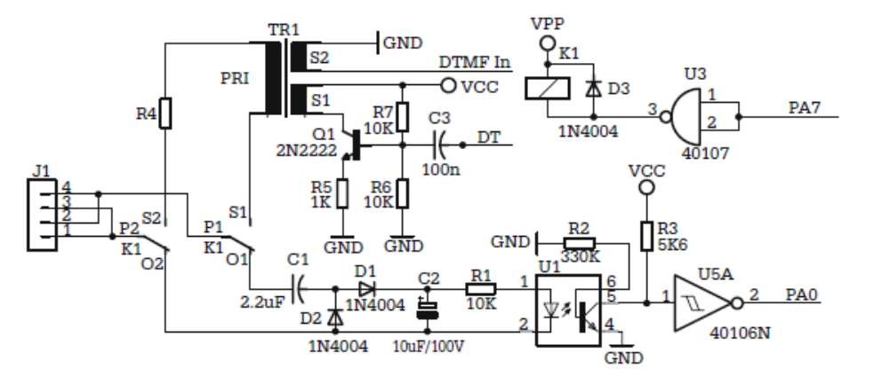
Ring detector and auto-answer circuits

Slide 19
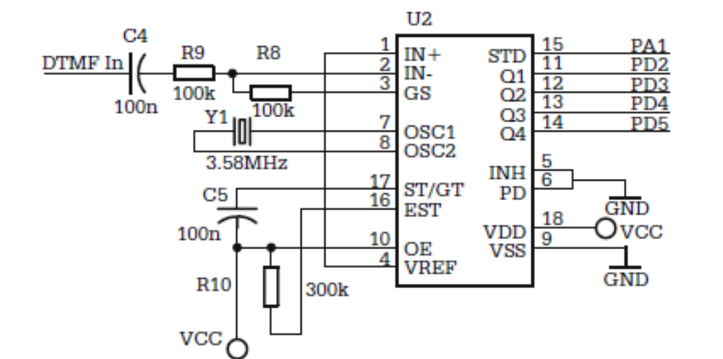
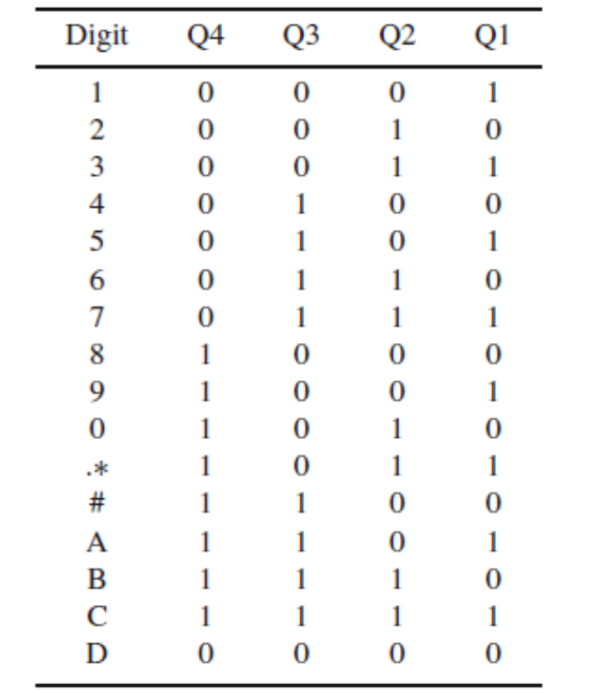
Schematic of the DTMF decoder circuit

Slide 20
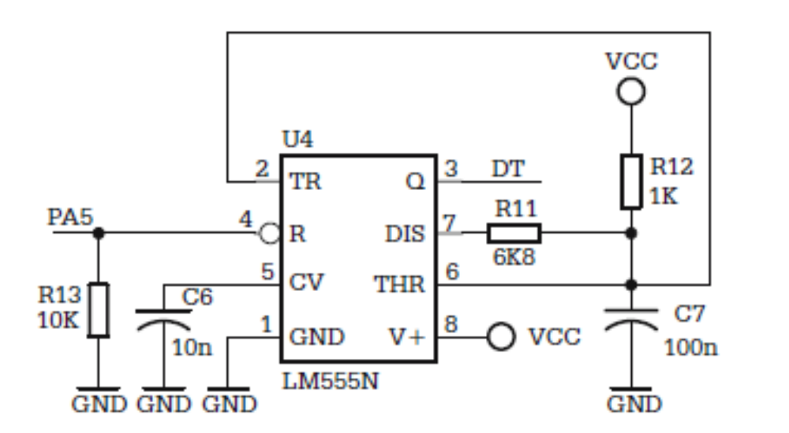
-- Schematic of the multivibrator that generates the dialog tones

Slide 21
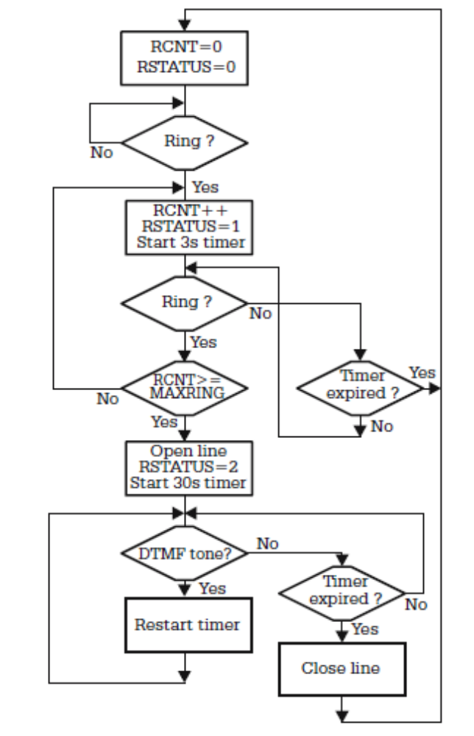

Slide 22
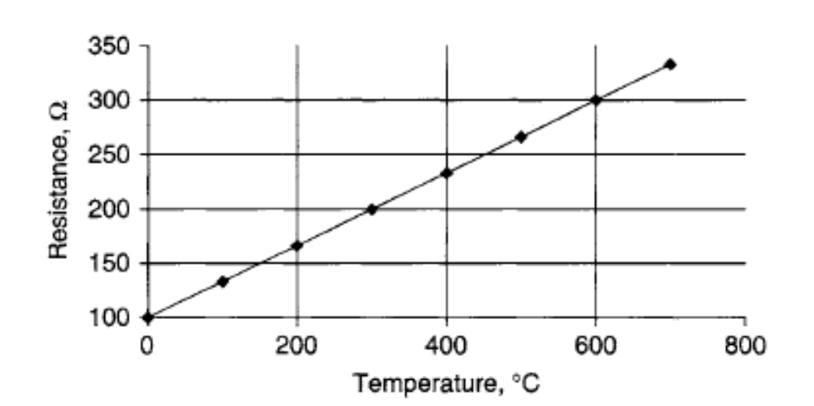
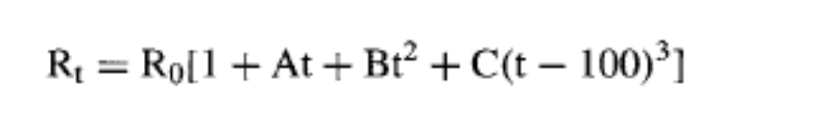
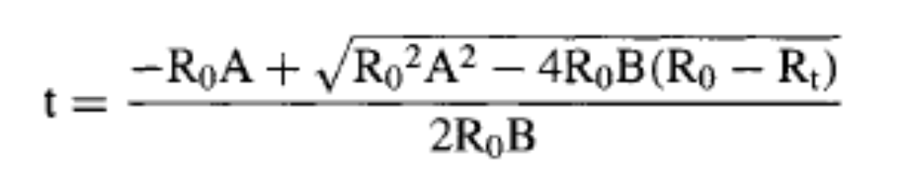
Designing a microcontroller based temperature measurement system using an RTD: This project measures the temperature with a Platinum RTD and then displays on a LCD every second:
RTD principles
Temperature-resistance relationship of the RTDs
Simple voltage source circuit

Slide 23
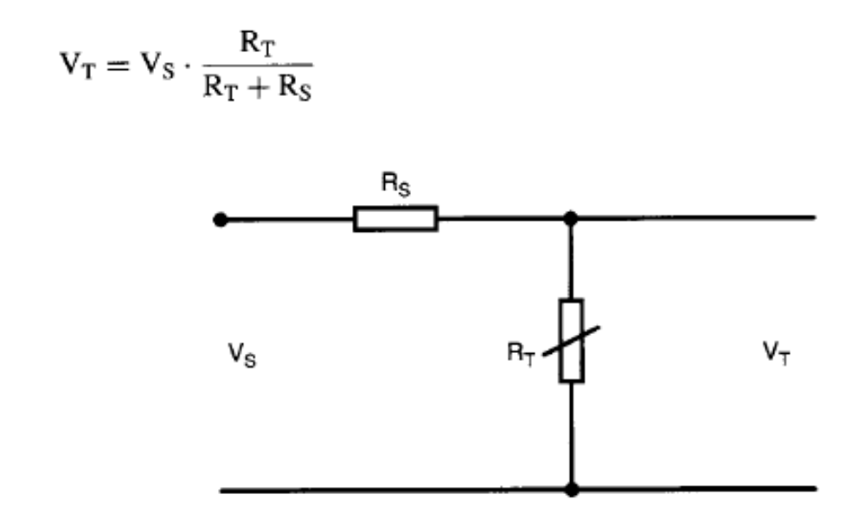
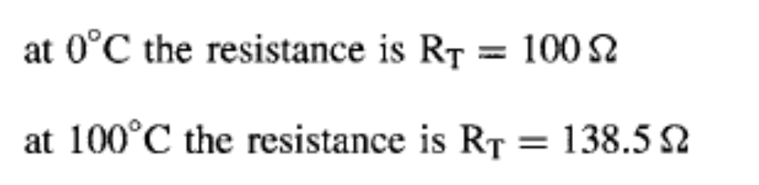
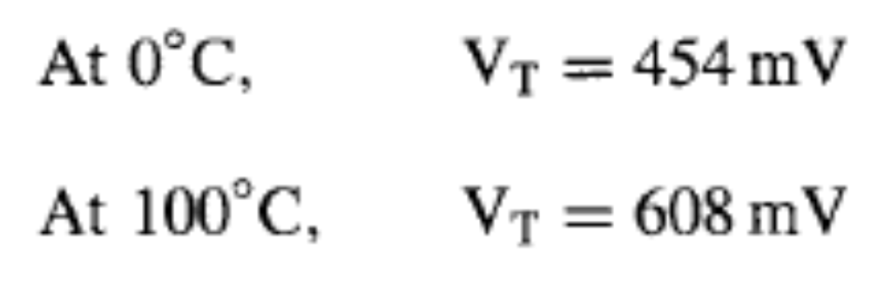
Simple voltage source circuit (Simple monitoring system)

Slide 24
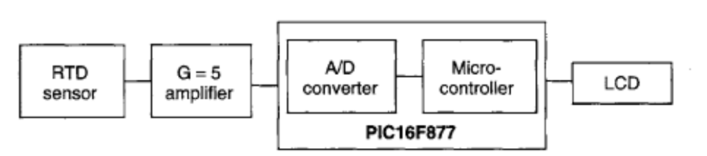
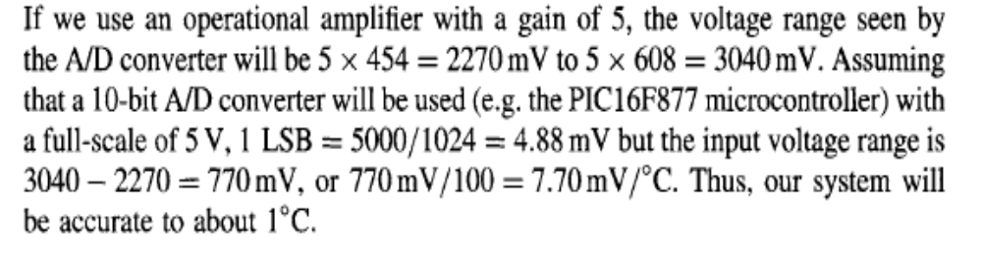

Slide 25
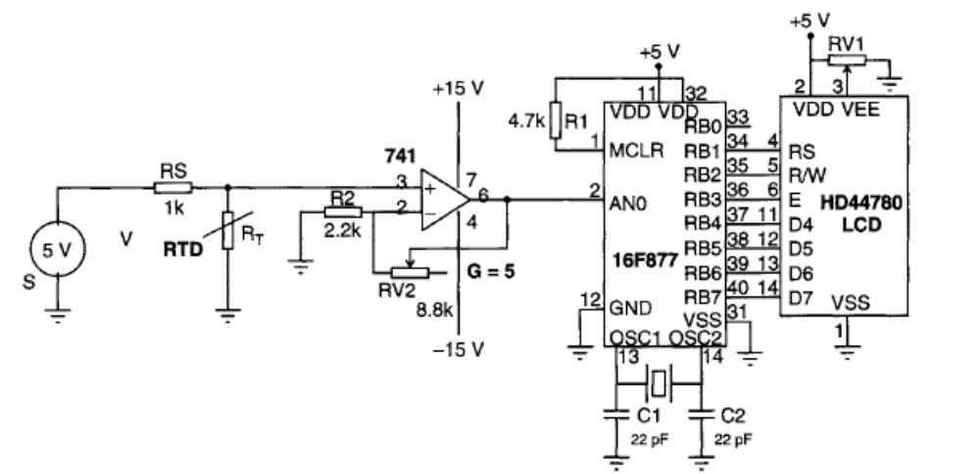

Slide 26
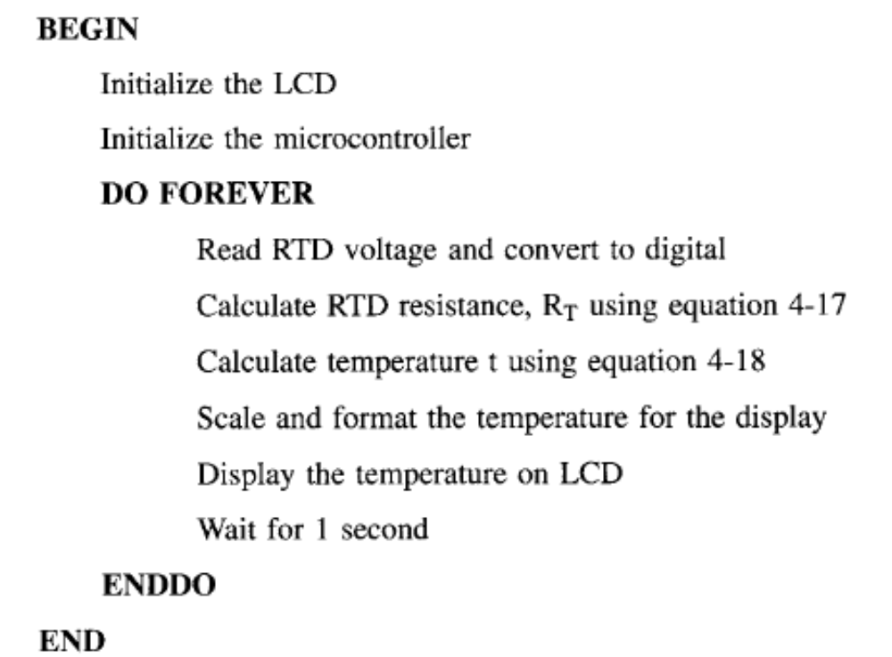

Slide 27
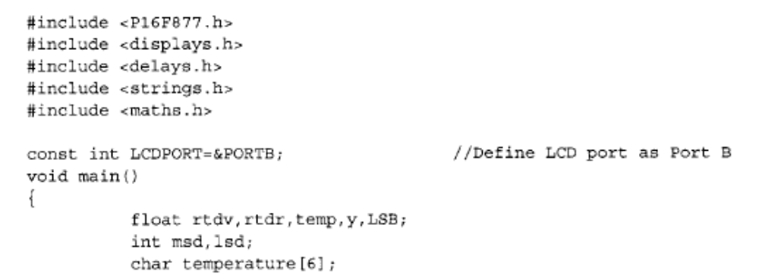

Slide 28
